Slide 1
Data Structures and Algorithms

Slide 2
Chapter Eight
Advanced Sorting Algorithms

Slide 3
Efficient sorting algorithms
Shell Sort
Quick Sort
Merge Sort
Heap sort

Slide 4
Shell Sort
The shell sort, also known as the diminishing increment sort, was developed by Donald L. Shell in 1959.
The idea behind shell sort is that it is faster to sort an array if parts of it are already sorted.
The original array is first divided into a number of smaller subarrays, these subarrays are sorted, and then they are combined into the overall array and this is sorted.
Pseudocode for shell sort:
Divide data into h subarrays
for (i = 1; i < h; i++)
Sort subarray i
Sort array data

Slide 5
How should the original array be divided into sub-arrays?
One approach would be to divide the array into a number of sub-arrays consisting of contiguous elements (i.e. elements that are next to each other).
For example, the array [a,b,c,d,e,f] could be divided into the sub-arrays [a,b,c] and [d,e,f].
However, shell sort uses a different approach: the sub-arrays are constructed by taking elements that are regularly spaced from each other.
For example, a sub-array may consist of every second element in an array, or every third element, etc.
For example, dividing the array [a,b,c,d,e,f] into two sub-arrays by taking every second element [a,c,e] and [b,d,f]

Slide 6
Cont..
Actually, shell sort uses several iterations of this technique.
First, a large number of sub-arrays, consisting of widely spaced elements, are sorted.
Then, these sub-arrays are combined into the overall array, a new division is made into a smaller number of sub-arrays and these are sorted.
In the next iteration a still smaller number of sub-arrays are sorted.
This process continues until one sub-array is sorted, the original array itself.

Slide 7
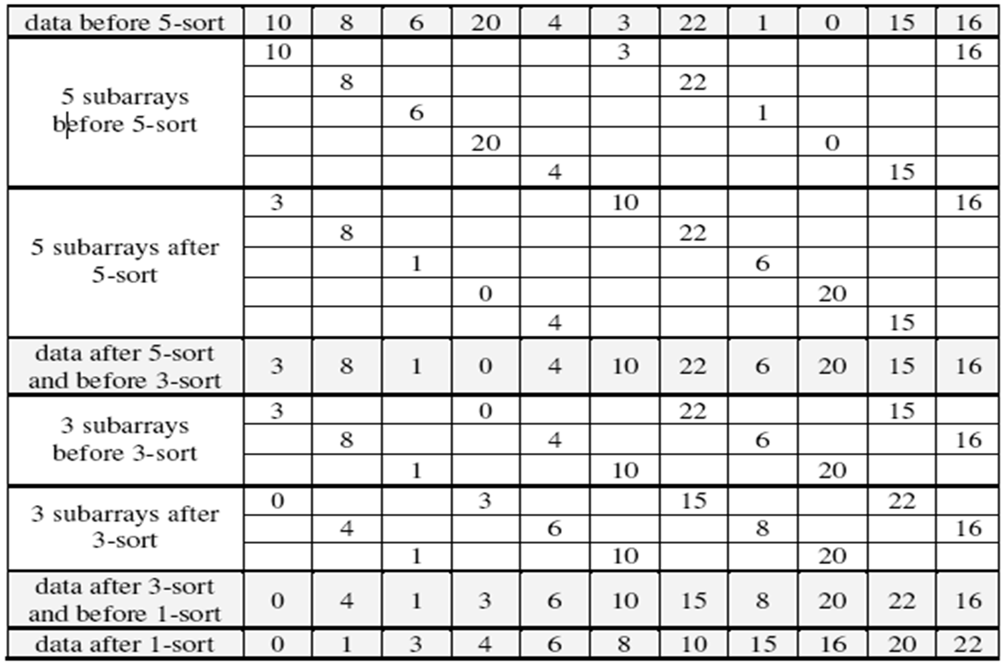

Slide 8
Cont..
In the first iteration, five sub-arrays are constructed by taking every fifth element.
These sub-arrays are sorted (this phase is called the 5-sort).
In the second iteration, three sub-arrays are constructed by taking every third element, and these arrays are sorted (the 3-sort).
In the final iteration, the overall array is sorted (the 1-sort).
Notice that the data after the 3-sort but before the 1-sort is almost correctly ordered, so the complexity of the final 1-sort is reduced.

Slide 9
Cont..
In the above example, we used three iterations: a 5-sort, a 3-sort and a 1-sort.
This sequence is known as the diminishing increment.
But how do we decide on this sequence of increments?
Unfortunately, there is no definitive answer to this question.
In the original algorithm proposed by Donald L. Shell, powers of 2 were used for the increments, e.g. 16, 8, 4, 2, 1.
However, this is not the most efficient technique.
Experimental studies have shown that increments calculated according to the following conditions lead to better efficiency:
h1 = 1
hi+1 = 3hi + 1
For example, for a list of length 10,000 the sequence of increments would be 3280, 1093, 364, 121, 40, 13, 4, 1.

Slide 10
Cont..
Another decision that must be made with shell sort is what sorting algorithms should be used to sort the sub-arrays at each iteration?
A number of different choices have been made: for example, one technique is to use insertion sort for every iteration and bubble sort for the last iteration.
Actually, whatever simple sorting algorithms are used for the different iterations, shell sort performs better than the simple sorting algorithms on their own.
It may seem that shell sort should be less efficient, since it performs a number of different sorts, but remember that most of these sorts are on small arrays, and in most cases the data is already almost sorted.
An experimental analysis has shown that the complexity of shell sort is approximately O(n^{1.25}), which is better than the O(n²) offered by the simple algorithms.

Slide 11
Example2:
sort: (5, 8, 2, 4, 1, 3, 9, 7, 6, 0)
Solution:
4 – sort
Sort(5, 1, 6) – 1, 8, 2, 4, 5, 3, 9, 7, 6 , 0
Sort(8, 3, 0) – 1, 0, 2, 4, 5, 3, 9, 7, 6, 8
Sort(2, 9) – 1, 0, 2, 4, 5, 3, 9, 7, 6, 8
Sort(4,7) - 1, 0, 2, 4, 5, 3, 9, 7, 6, 8
1- sort
Sort(1, 0, 2, 4, 5, 3, 9, 7, 6, 8) – 0,1, 2, 3, 4, 5, 6, 7,8,9

Slide 12
Quick sort
Quicksort was developed by C. A. R. Hoare in 1961, and is probably the most famous and widely used of sorting algorithms.
The guiding principle behind the algorithm is similar to that of shell sort: it is more efficient to sort a number of smaller sub-arrays than to sort one big array

Slide 13
Algorithm
In quick sort the original array is first divided into two sub-arrays, the first of which contains only elements that are less than a chosen element, called the bound or pivot.
The second sub-array contains elements that are greater than the bound.
If each of these sub-arrays is sorted separately they can be combined into a final sorted array.
To sort each of the sub-arrays, they are both sub-divided again using two new bounds, making a total of 4 sub-arrays.
The partitioning is repeated again for each of these sub-arrays, and so on until the sub-arrays consist of a single element each, and do not need to be sorted

Slide 14
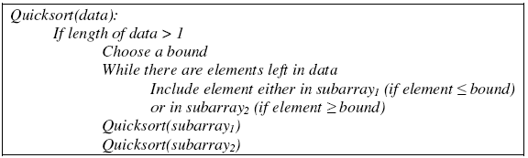
Cont..
Quick sort is inherently recursive in nature, since it consists of the same simple operation (the partitioning) applied to successively smaller sub-arrays.
Pseudo code for quicksort is given below:

Slide 15
Cont..
The pivot element can be selected in many ways.
We may select the first element as a pivot, or we may select the middle element of the array or may be a randomly selected pivot /bound element can be used.
The following example demonstrates a pivot element selected from the middle of the data.
In the average, quicksort has complexity of nlogn.

Slide 16
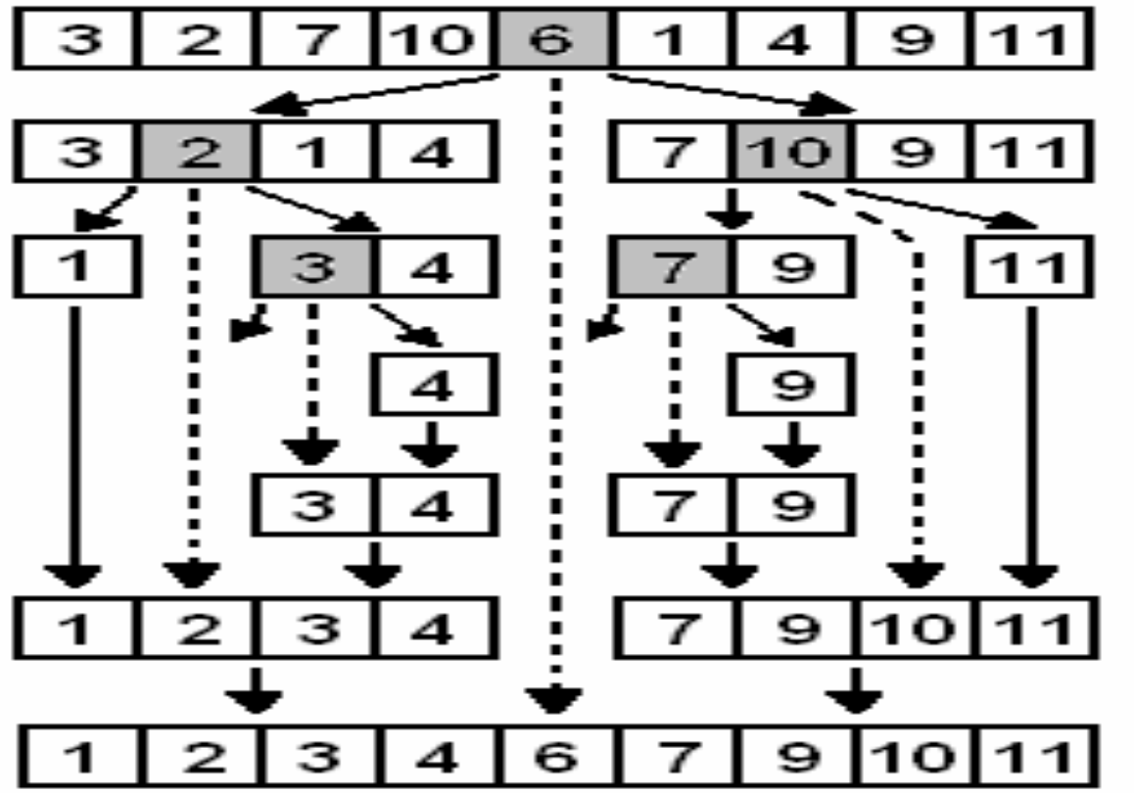
Cont..

Slide 17
Cont..
To begin with, the middle element 6 is chosen as the bound, and the array partitioned into two sub-arrays.
Each of these sub-arrays are then partitioned using the bounds 2 and 10 respectively.
In the third phase, two of the four sub-arrays only have one element, so they are not partitioned further.
The other two sub-arrays are partitioned once more, using the bounds 3 and 7.
Finally we are left with sub-arrays consisting of only a single element.
At this point, the sub-arrays and bounds are recombined successively, resulting in the sorted array.

Slide 18
Merge sort
Merge sort also works by successively partitioning the array into two sub-arrays, but it guarantees that the sub-arrays are of approximately equal size.
This is possible because in merge sort the array is partitioned without regard to the values of their elements: it is simply divided down the middle into two halves.
Each of these halves is recursively sorted using the same algorithm.
After the two sub-arrays have been sorted, they are merged back together again.
The recursion continues until the sub-arrays consist of a single element, in which case they are already sorted.

Slide 19
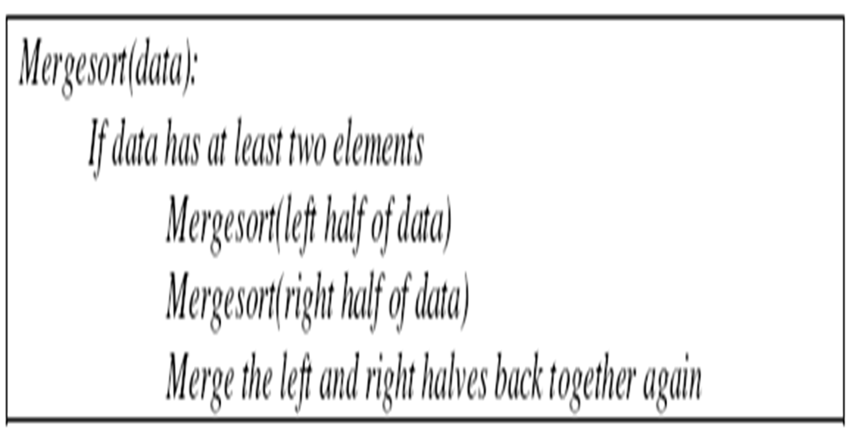
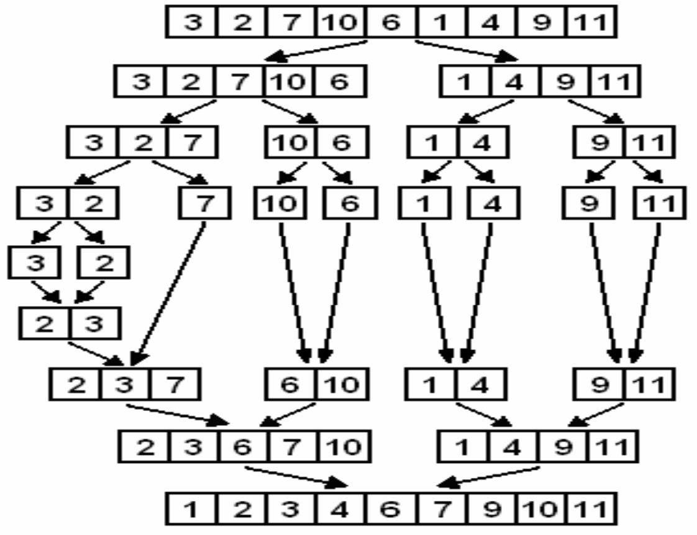
Example

Slide 20
Heaps
Heap is a binary tree that has two properties:
The value of each node is greater than or equal to the values stored in each of its children.
The tree is perfectly balanced, and the leaves in the last level are all in the leftmost positions. (filled from left to right)
A property of the heap data structure is that the largest element is always at the root of the tree.
A common way of implementing a heap is to use an array.

Slide 21
Heap Sort
The heap sort works by first rearranging the input array so that it is a heap, and then removing the largest elements from the heap one by one.
Pseudocode for the heap sort is given below:
HeapSort(data):
Transform data into a heap
for (i = n-1; i > 1; i--)
Swap the root with element in position I
Restore the heap property for the tree data[0] … data[i-1]

Slide 22
Example

